Slide 1

Datu-baseen kudeaketa DB management
2024-02-15
SISA-1
ANDONI AGIRRE

Slide 2
CONTENTS
01
02
03
04
Cartesian product
INNER JOIN
Exam overview – Q4 d) onwards
LEFT JOIN

Slide 3



HOW TO APPROACH (ALMOST) ANYTHING
If in doubt, run the code
Visualize, visualize, visualize
Experiment, experiment, experiment

Slide 4
LET’S IMPORT SOME DATABASES
db1: datu_baseak_join
db2: left_join_lesson
db3: 1asir_cities

Slide 5

CARTESIAN PRODUCT

Slide 6








CARTESIAN PRODUCT
“A Cartesian product, or a cross product, is the result achieved from multiplication of two sets. This is done by multiplying all the possible pairs from both the sets.”
It is useful when you need to perform combinations between two or more tables
Notes:
highlight that this is not difficult! (even though the name may sound like complicated stuff)

Slide 7
CARTESIAN PRODUCT - SQL
How can this be useful in relational databases?
How can we perform this cartesian product using SQL?
Let’s find out! (we will be using datu_baseak_join db)

Slide 8
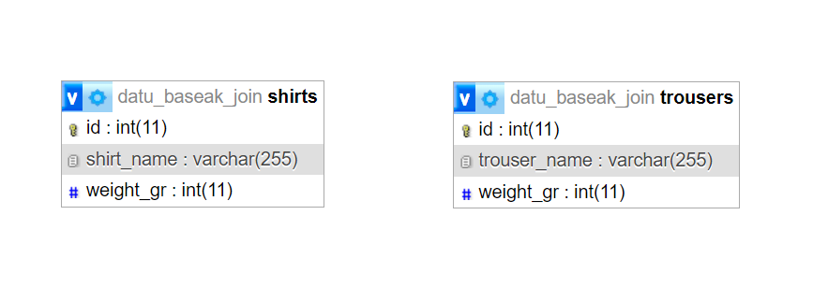
CARTESIAN PRODUCT - DATASET
datu_baseak_join (db)

Slide 9
CARTESIAN PRODUCT - OUR GOAL
We are working in an online retail shop and our sales manager is calculating the shipment costs (which heavily depend on the weight of the package)
He has asked us to show him the top 3 lightest shirt+trouser combination:
Shirt_name | Trouser_name | Weight_gr
Synthetic | Sport tights | 330
Cotton | Sport tights | 350
Synthetic | chinos | 380

Slide 10

CARTESIAN PRODUCT – SQL SYNTAX
Try the following. What does this query do?:
SELECT * FROM shirts, trousers
For more clarity, sort the results by “shirt_name” columna in ASC order
What does this query do? Is it the same as INNER JOIN? Why?

Slide 11
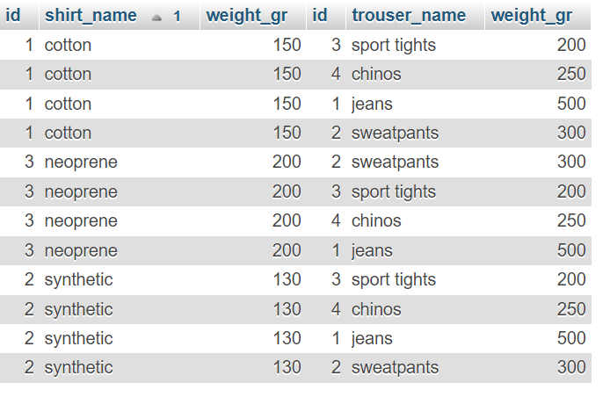
CARTESIAN PRODUCT – SQL SYNTAX
SQL engine will iterate through the trousers table as many times as there are records in the shirts table, returning all the possible combinations (3x4=12 in this case)
Notes:
Be very careful with cartesian product. It is resource intensive (bear in mind that the output of a cartesian product query will return a considerable amount of rows, nº of rows returned will be rows from table 1 multiplied by rows from table 2 !!!)

Slide 12
CARTESIAN PRODUCT – EXERCISE (10min)
Display the top 3 lightest shirt+trouser combination like this:
Shirt_name | Trouser_name | weight_gr
Synthetic | Sport tights | 330
Cotton | Sport tights | 350
Synthetic | chinos | 380

Slide 13

INNER JOIN

Slide 14
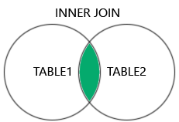
INNER JOIN – WHAT IS IT?
INNER JOIN is a SQL clause that is used when we need to extract information from more than one table. These tables have some kind of relationship.
Table 1 and Table 2 relationship is normally determined by primary key (PK) and foreign key (FK)
You can use more than 1 INNER JOIN statement in the same query

Slide 15
INNER JOIN – W3SCHOOLS
Let’s use w3 schools mysql database engine and tables for practice
The tables we will be using are “Orders” and “Customers”
These tables are linked with CustomerID column
CustomerID is the PK from Customers table and it is FK of Orders table
Notes:
Share screen and go to w3 schools mysql

Slide 16
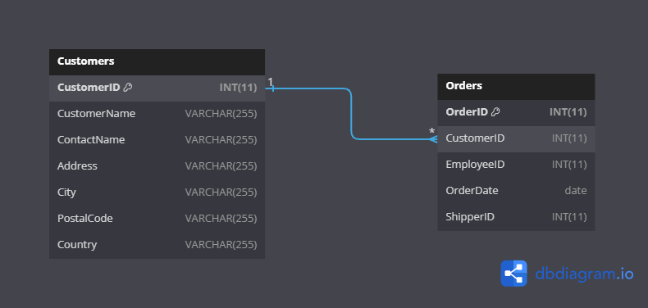
INNER JOIN - W3SCHOOLS TABLES
northwind (db)

Slide 17
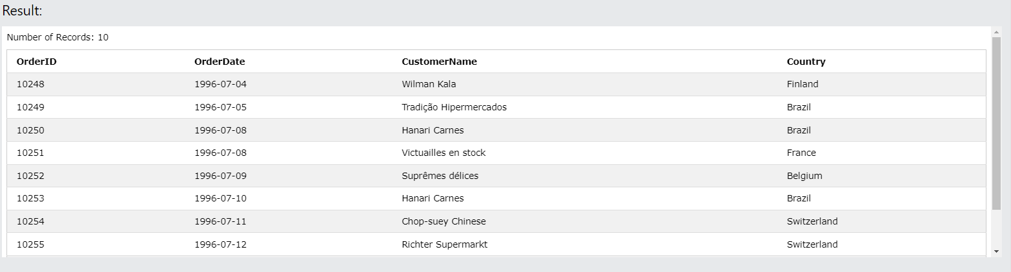
INNER JOIN – EXERCISE 1 (3 MIN)
--Display the order id, order date, customer name and customer country. Sort it by order date, ascending
Notes:
INNER JOIN

Slide 18
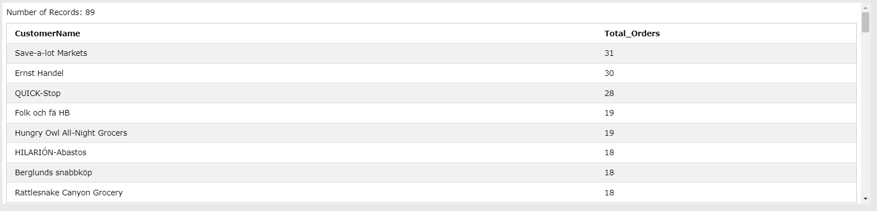
INNER JOIN – EXERCISE 2 (5 min)
--Display the nº of orders per customer. Sort it by total orders columns, descending
Notes:
INNER JOIN, GROUP BY

Slide 19
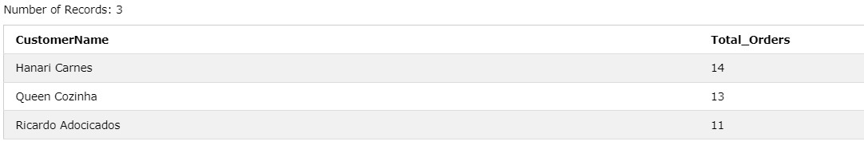
INNER JOIN – EXERCISE 3 (5 min)
--Display the nº of orders per customer. This time we want only customers from Brazil. Also, we only want those customers that have ordered more than 10 items. Sort the results based on the total orders column, descending
Notes:
INNER JOIN, WHERE, GROUP BY, HAVING

Slide 20



CONCLUSIONS
CARTESIAN PRODUCT is NOT equal to INNER JOIN. Each one has its own usage
INNER JOIN can be performed (and it is often performed) between more than 2 tables (we will cover this in the exam overview)
Be careful with cartesian product. The rows that this query returns are rows from table 1 multiplied by rows from table 2. If table 1 and/or table 2 have a considerable amount of rows this query will be expensive (resource intensive and potentially expensive)

Slide 21

EXAM OVERVIEW – Q4 d) onwards

Slide 22

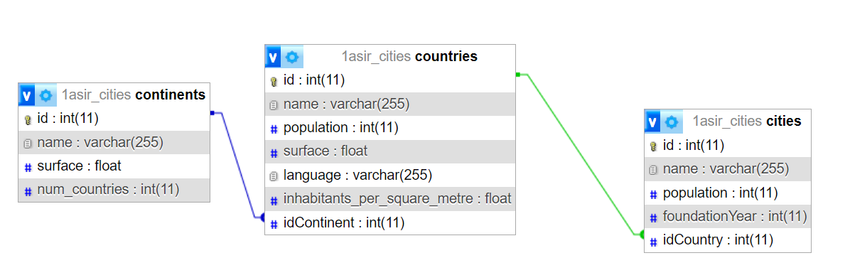
OUR DATABASE
1asir_cities (db)
1
1
n
n
Notes:
Highlight the importance of writing things in paper and mentally structuring the hierarchy of tables, from left to right (this is a personal advice)
Num_citizens per continent, how would you do this?
SELECT continents.name, SUM(cities.population) as 'n_citizens'
FROM continents
INNER JOIN countries on continents.id=countries.idContinent
INNER JOIN cities ON countries.id=cities.idCountry
GROUP BY continents.name;

Slide 23
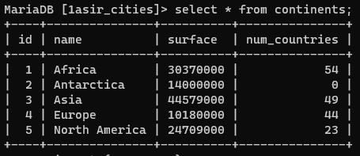
OUR DATA – CONTINENTS table

Slide 24
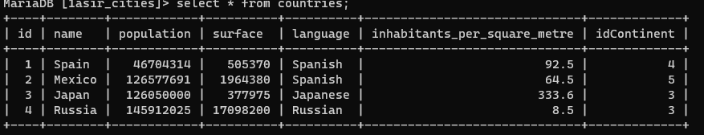
OUR DATA – COUNTRIES table

Slide 25
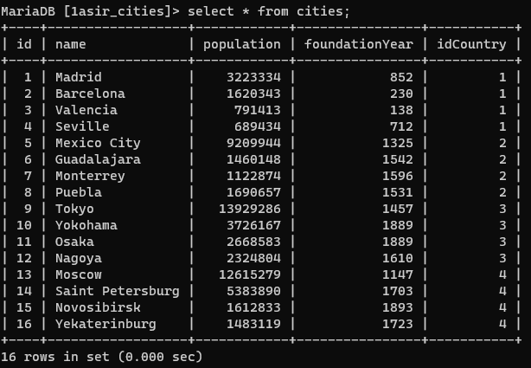
OUR DATA – CITIES table

Slide 26

LET’S GO!
LINK TO BLANK EXAM
Notes:
7 kontsulta daka (d…i), 5minutu/kontsulta (ordu erdi +ó-)

Slide 27
LEFT JOIN

Slide 28
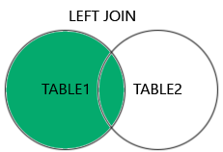
LEFT JOIN
The LEFT JOIN (in some cases also named LEFT OUTER JOIN) keyword returns all records from the left table (table1) and the matching records from the right table (table2). The result is 0 records from the right side, if no match is found

Slide 29
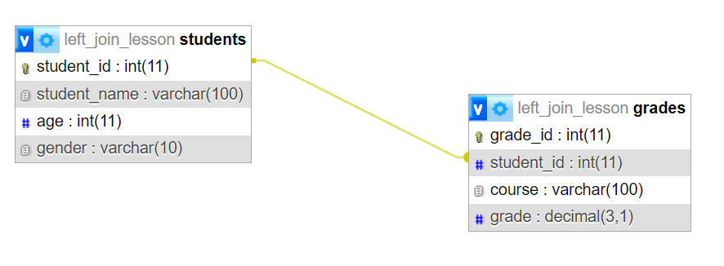
LEFT JOIN – HANDS ON
1
n
We will be using left_join_lesson db

Slide 30
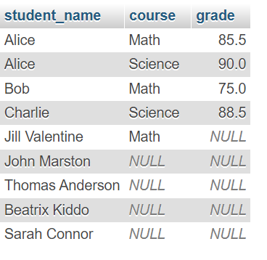

LEFT JOIN - HANDS ON
TASK 1: Display all the students and also their grades
students
grades

Slide 31
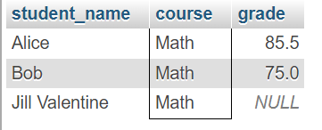
LEFT JOIN - HANDS ON
TASK 2: Display all the students and also their grades in the ‘Math’ course
students
grades

Slide 32

LEFT JOIN - HANDS ON
TASK 3: Is LEFT JOIN a symmetrical operation? Test it out (if in doubt, run the code)
=
students
grades
grades
students

Slide 33
RIGHT JOIN
Now that you have seen INNER JOIN and LEFT JOIN, it’s time you test RIGHT JOIN
grades
students

Slide 34
ADDITIONAL CONTENT AND EXERCISES
UD05-06 SQL-DDL-DML-English

